Slide 1
Multimodal RAG LLM in Education - LMI
Vishwanath Guruvayur Luke Napolitano Doruk Ozar Bereket Tafesse

Slide 2
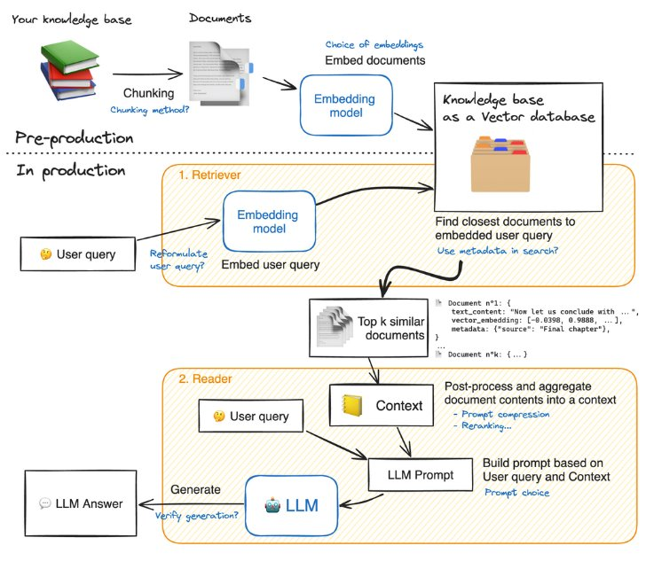
Project Purpose and Background
Purpose
Enhance Independent Learning
Explore Multimodal RAG Use Cases
Assess Gen AI's Role in Education
Background
Advancements in LLMs
Challenges with Multimodal Data
Retrieval-Augmented Generation (RAG)

Slide 3
The Data
Using data from Foundations of Machine Learning class
Textbook
Slide decks
Transcripts
Currently have ~20% of data available (3 weeks of course material)
What we’re tuning
Indexing - How are we storing our data?
Retrieval - How do we recall the right data?
Generation - How do we pick the right LLM?

Slide 4
Assumptions, Scope, and Limitations
Assumptions
Vectorization for all multimodal data will work as needed
Retriever will route from the right document stores
Generation will not hallucinate too much and we can actually evaluate it as an educational tool
Scope
In Scope
Evaluation of different data storage methods and LLMs
Content for DS 3001 (Foundations of Machine Learning)
Not In Scope
Front end for chat-bot
Testing in a classroom environment
Limitations
Possible computation limitations

Slide 5
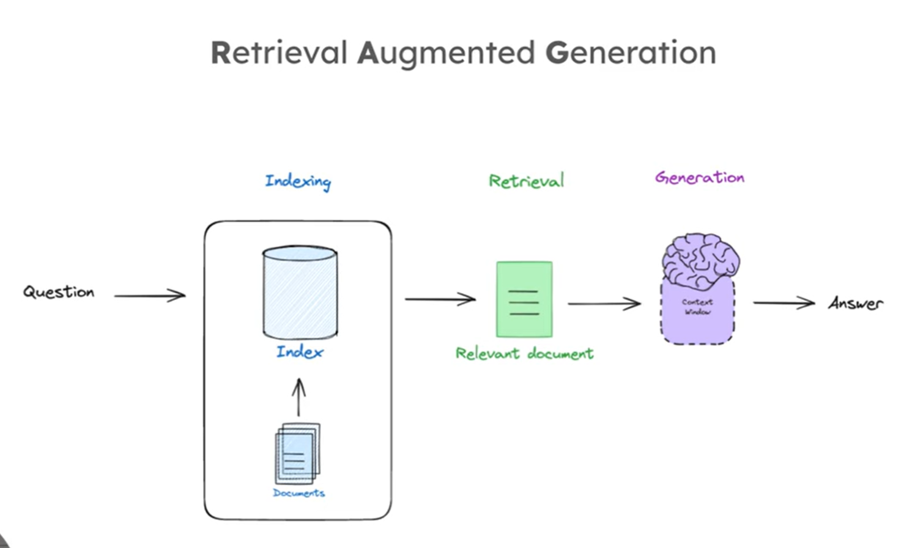
Background Material from Fall Sem
LangChain videos
RAG with LangChain
Active Learning Lab material
Retrieval Augmented Generation for Knowledge-Intensive NLP Tasks
Hugging Face Codebooks
Team is already working on RAG for text analysis
We are working on multimodal RAG

Slide 6
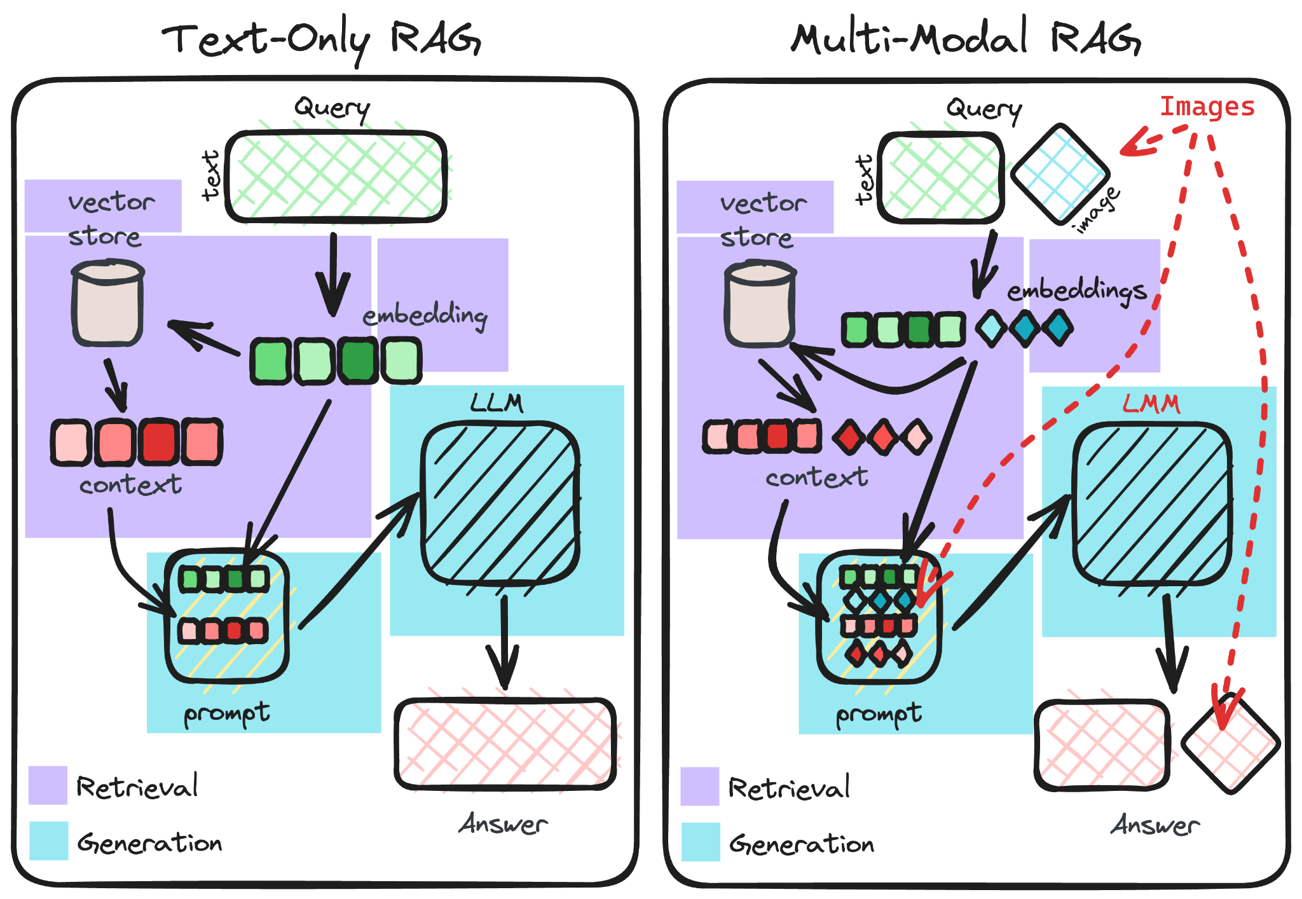
Project Plan & Objectives
Compare and optimize the efficiency of RAG based LLM model for Course Content With the base Zero-Shot LLM as reference, we will integrate the course content in the form of text, slides, and videos (with incremental comparative analysis)
The main idea is to improve the context window quality and reduce atrophy in responses!
5 Major Sub-Parts in the Project: *Major experimental areas
Preparing Multimodal Data Pipelines
Embedding Data into Vector Space*
Setup RAG System on the Vector Space*
Fit best LLM to the RAG Framework*
Evaluate and tune the RAG Model based on responses
First Major Goal: MVP up and running by end of Jan’25

Slide 7
Questions?

Slide 8
References
https://arxiv.org/abs/2005.11401
https://www.youtube.com/playlist?list=PLfaIDFEXuae2LXbO1_PKyVJiQ23ZztA0x
https://huggingface.co/learn/cookbook/advanced_rag#load-your-knowledge-base
https://myuva-my.sharepoint.com/:p:/g/personal/bw2zd_virginia_edu/EdbbllCUsbhGiJMUX5OEYtwBVEhmBvsy8LEkfRdlMQWt4A?rtime=B9nd1ecS3Ug

